Slide 1






EDA of FACEBOOK user data

Slide 2
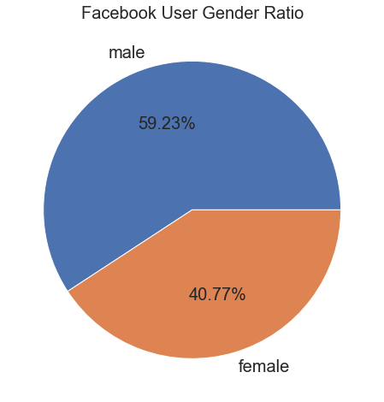
FACEBOOK USERS: Gender-wise ratio
Graph indicates that:
Total No. of Male Users
>
Total No. of Female Users

Slide 3
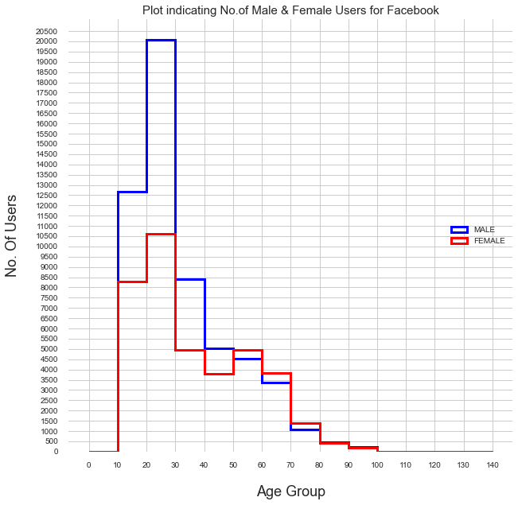
No. of FACEBOOK USERS (age-wise)
Age-wise analysis
Maximum Users belong to age group 13-30 years
13-40 years: Male Users drastically more than Female Users
50-80 years: Female Users slightly more than Male Users

Slide 4

Social networking skills of facebook users
Friend count
Friendship requests
initiated

Slide 5
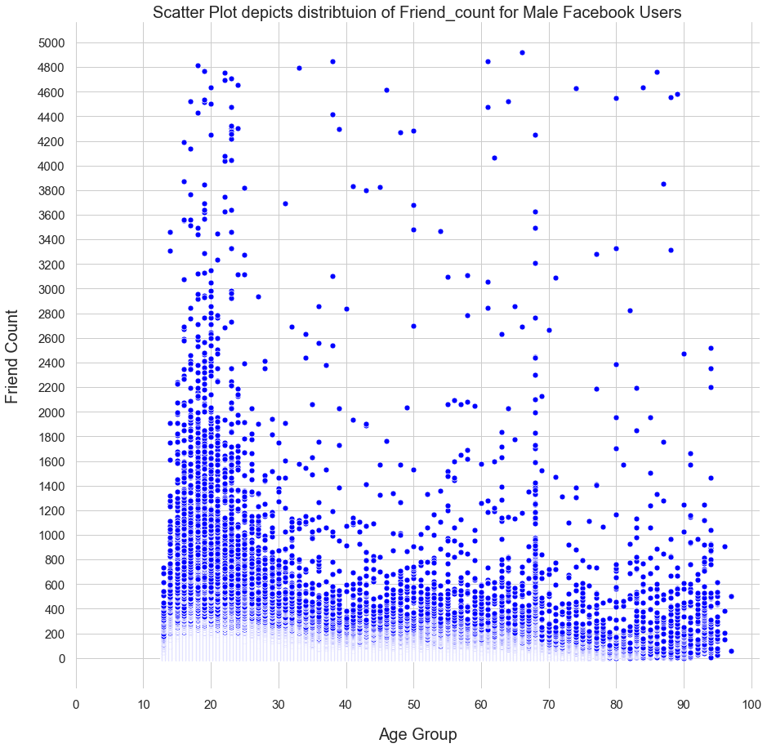
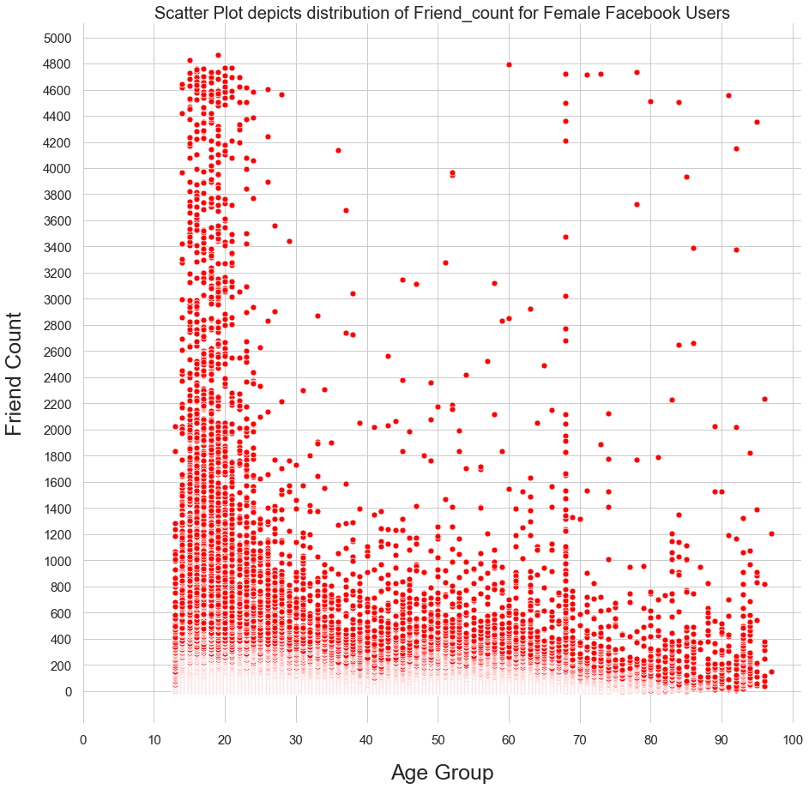
Friend count of FACEBOOK USERS
MALE
FEMALE
Friend_Count varies from ~ 0-5000 friends.
15-25 years: More no. of Female Users have a High friend_count than Male Users.
> 30years: Friend_count ~ 0-800 : Majority Users
Friend_Count ~ 800-5000: Fewer Users

Slide 6
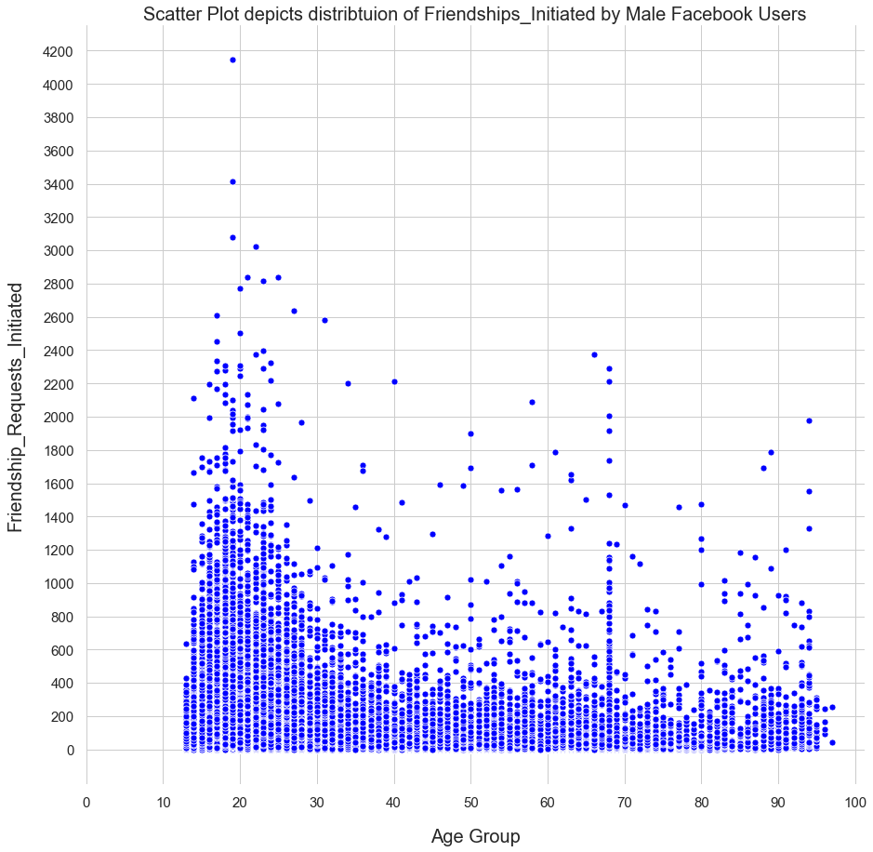
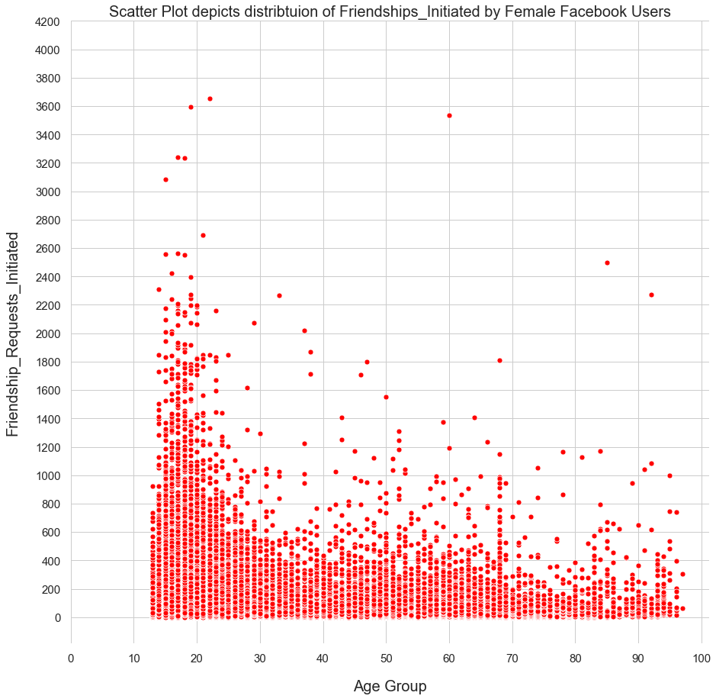
Friendship requests initiated (Age/gender-wise)
MALE
FEMALE
13-25years: Higher No. of Friendship_Requests Initiated than Users >25years
Users >30 years : Calculations show ~99% users have ~600 Friendship_Requests Initiated.

Slide 7
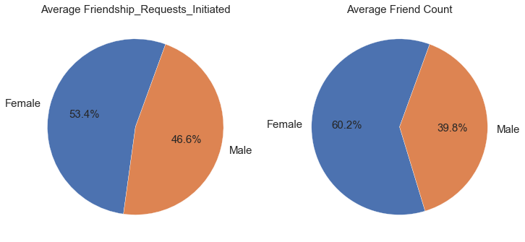
Comparison: ‘Friendship requests’ vs ‘friend count’
Avg. Friendship_Requests
Female Users > Male Users
Âvg. Friend_Count
Female Users > Male Users
Female Users
have a Higher
Social Networking Rate
than
Male Users
on Facebook

Slide 8

Active participation by facebook users
Likes received
Likes given

Slide 9
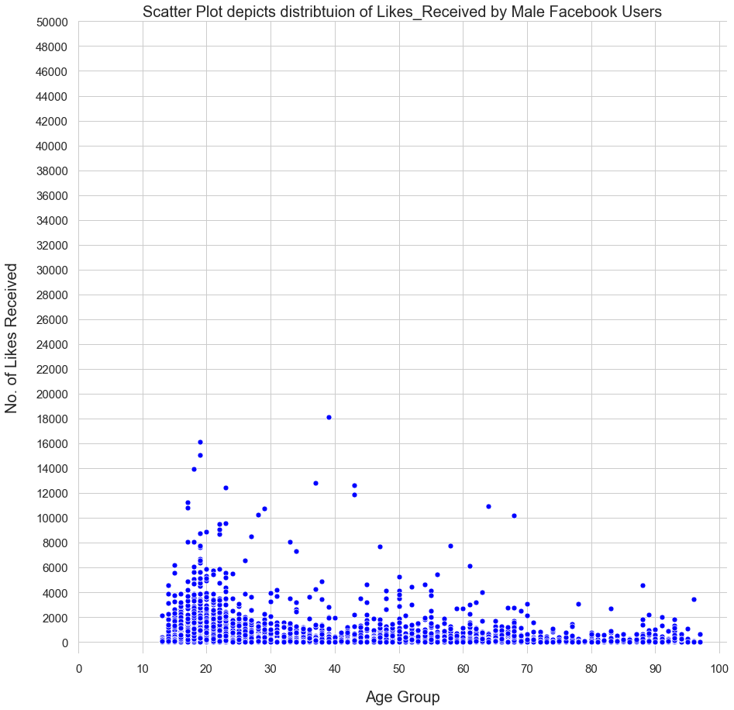
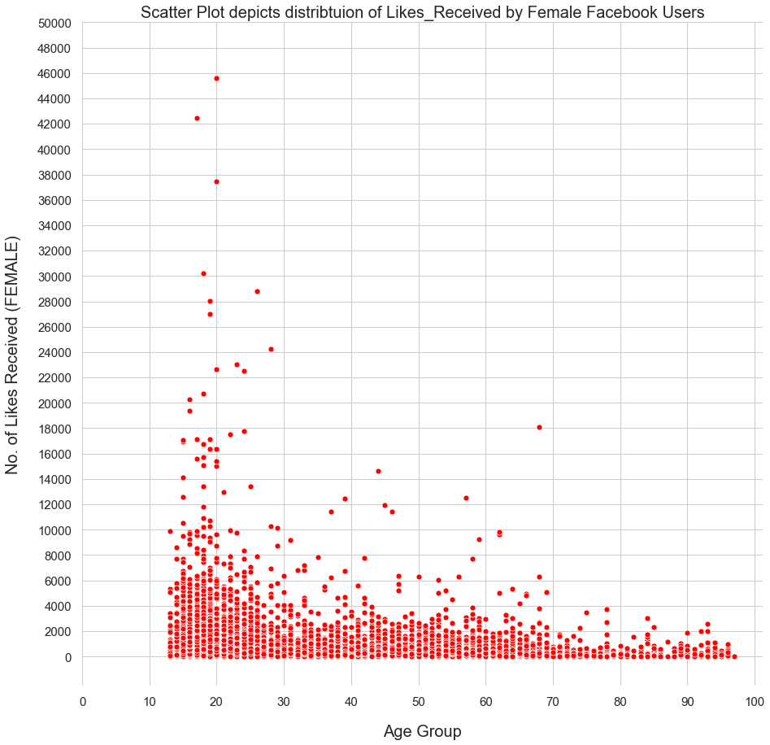
No. of Likes received by facebook users
MALE
FEMALE
Male Users: Likes_Received mostly 0-20,000 likes. There are 4 Male Users with Likes_Received >20,000.
Female Users: Likes_Received mostly 0-40,000 likes. There are 4 Female Users who have received >1Lakh Likes.
Extreme Likes_Rec. values could mean those Users are extremely popular on Facebook (for instance they could be a celebrity or well-known for their work and Facebook posts) or else this data is incorrectly recorded.

Slide 10
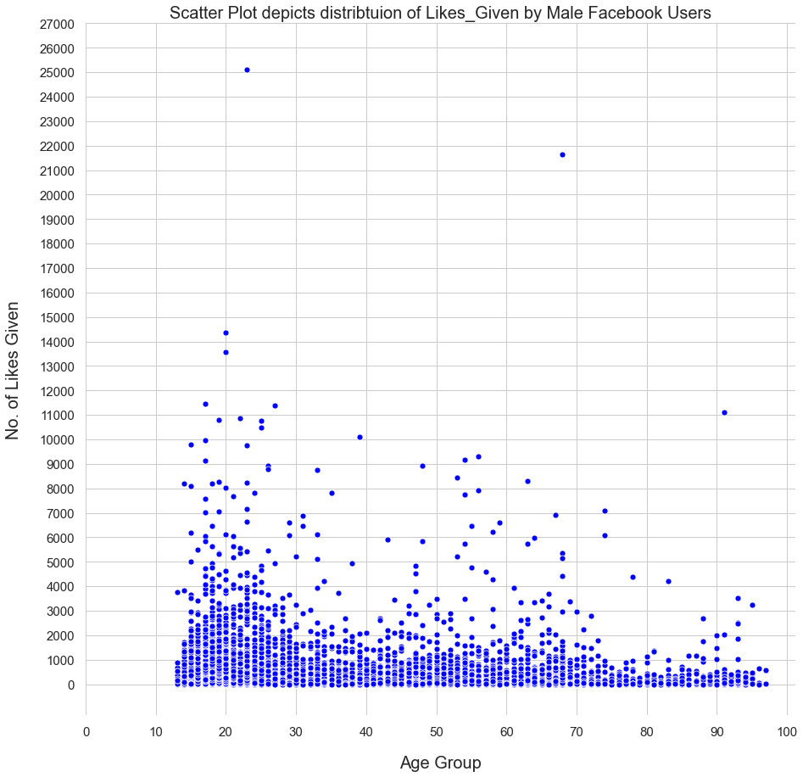
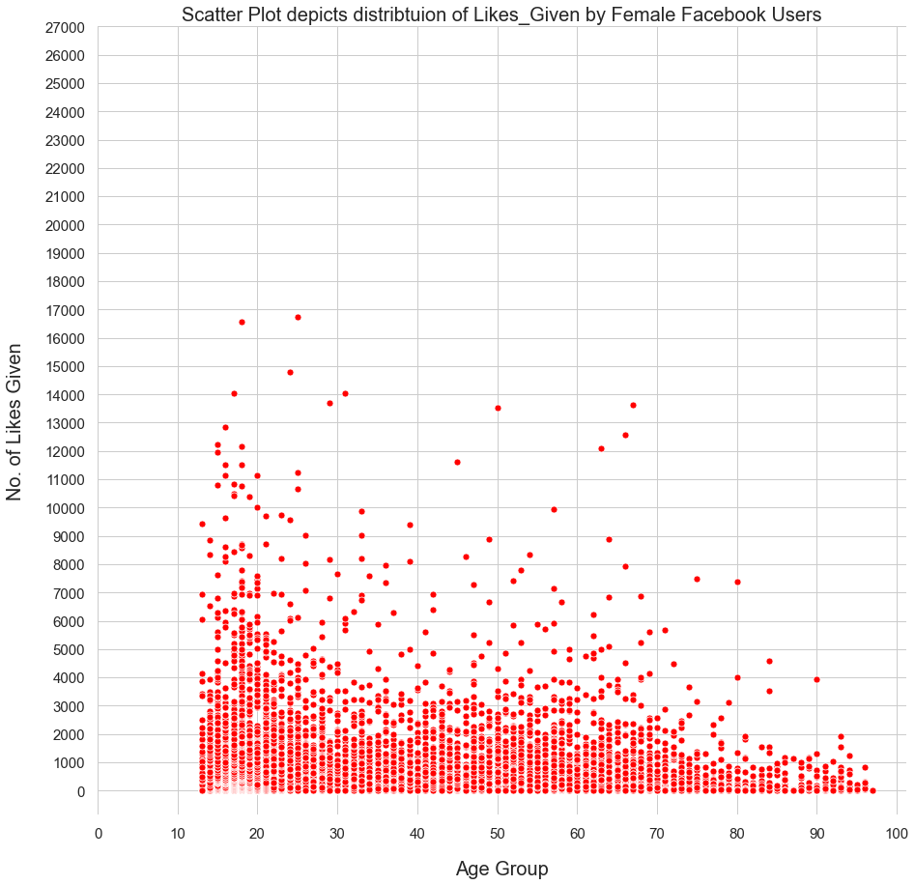
No. of Likes given by users
MALE
FEMALE
Female Users give more Likes to other Users as compared to Male Users.
13-30years: Max. No. of Female Users in this range give ‘Likes’ to other Users.

Slide 11
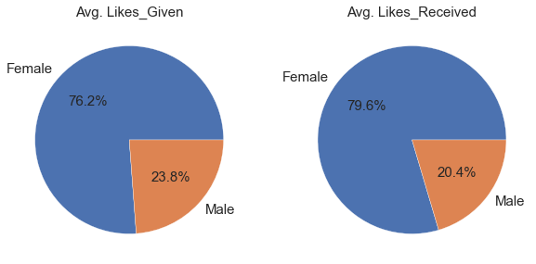
Comparison: ‘Likes_Given’ v/s ‘likes_received’
Female Users lead in both categories:
Avg. ‘Likes Received’ and ‘Likes Given’
Graphs could imply 2 situations:
Female Users are more Active (in posting articles etc.) than Male Users on Facebook
And/Or
Since Females Give more Likes, therefore they Receive more Likes on Facebook

Slide 12
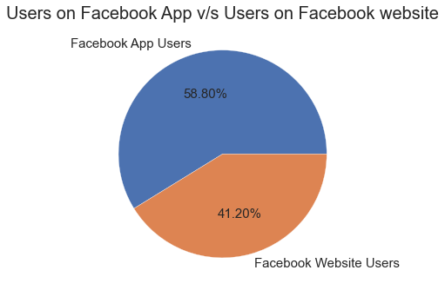
Users on Facebook App v/s Users on Facebook website
Users on Facebook App > Users on Facebook website

Slide 13
Conclusion
FACEBOOK – Worldwide Popular Social Networking Site for both Males & Females.
User Age Group: 13 – 90 years.
Maximum no. of Users belong to age group13-30years
Female Users have a bigger Social Network (no. of Friends) on Facebook as compared to Male Users.
Female Users are more Active on Facebook – Receiving and Giving more Likes to other Users than Male Users.
Facebook Users on Facebook App > Facebook Users on Facebook website
A small no. of Users are completely Passive on Facebook i.e No Friends, No Friendship_Requests Initiated and No Likes Given or Received by them.
FACEBOOK helps people connect world-wide

Slide 14
Thank you

